Slide 1
R programming
2022.02.17
簡廷因

Slide 2
Outline
Introduction to R
Install R & Rstudio
Basic R programming
Control Structures
Function
dplyr
R calling C/C++

Slide 3
Reference
Website:
http://cran.r-project.org/doc/manuals/R-intro.html
http://www.statmethods.net/
http://manuals.bioinformatics.ucr.edu/home/R_BioCondManual
https://rpubs.com/
Book
http://lib.yzu.edu.tw/ajaxYZlib/Search/Holding.aspx?BiblioSNo=676837
http://lib.yzu.edu.tw/ajaxYZlib/Search/Holding.aspx?BiblioSNo=857162
http://lib.yzu.edu.tw/ajaxYZlib/Search/Holding.aspx?BiblioSNo=857161
http://lib.yzu.edu.tw/ajaxYZlib/Search/Holding.aspx?BiblioSNo=856108

Slide 4
Introduction to R

Slide 5
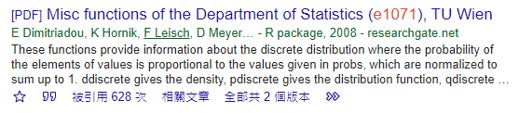
What is R?
R is a programming language and software environment for statistical computing and graphics
more than 19,000 additional packages (2020) available
You can make your own contribution in the future.

Slide 6
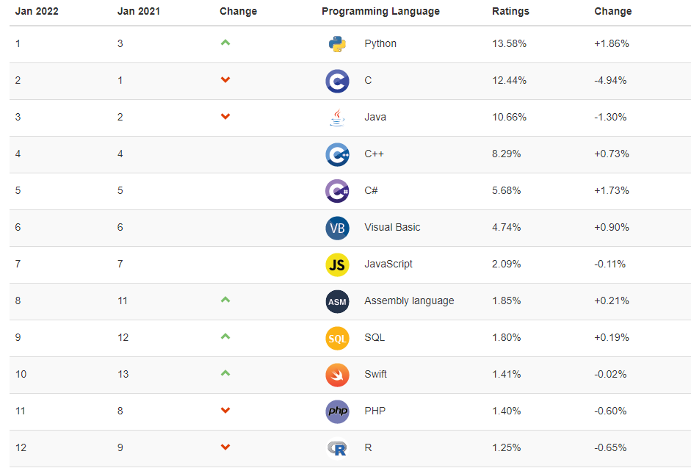
Introduction to R
Ref: http://www.tiobe.com/tiobe-index/

Slide 7

Introduction to R
Advantages :
Free
Cross platform
Integrate Hadoop
Modify code easily
Generate graphics easily and quickly
Disadvantages:
No friendly UI
Need to know packages and function name
SAS VA :
~150K / core

Slide 8
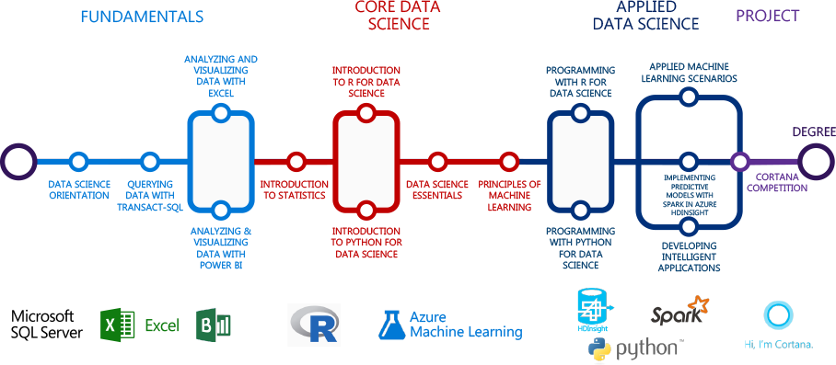
微軟資料科學學位認證

Slide 9
Install R & Rstudio

Slide 10
Install R & Rstudio
Step1: download R
https://cran.csie.ntu.edu.tw/bin/windows/base/R-4.1.2-win.exe
Version: 4.1.2
Step2:Install
Always "NEXT"
Step3: Finish

Slide 11

Rstudio (http://www.rstudio.com/)

Slide 12
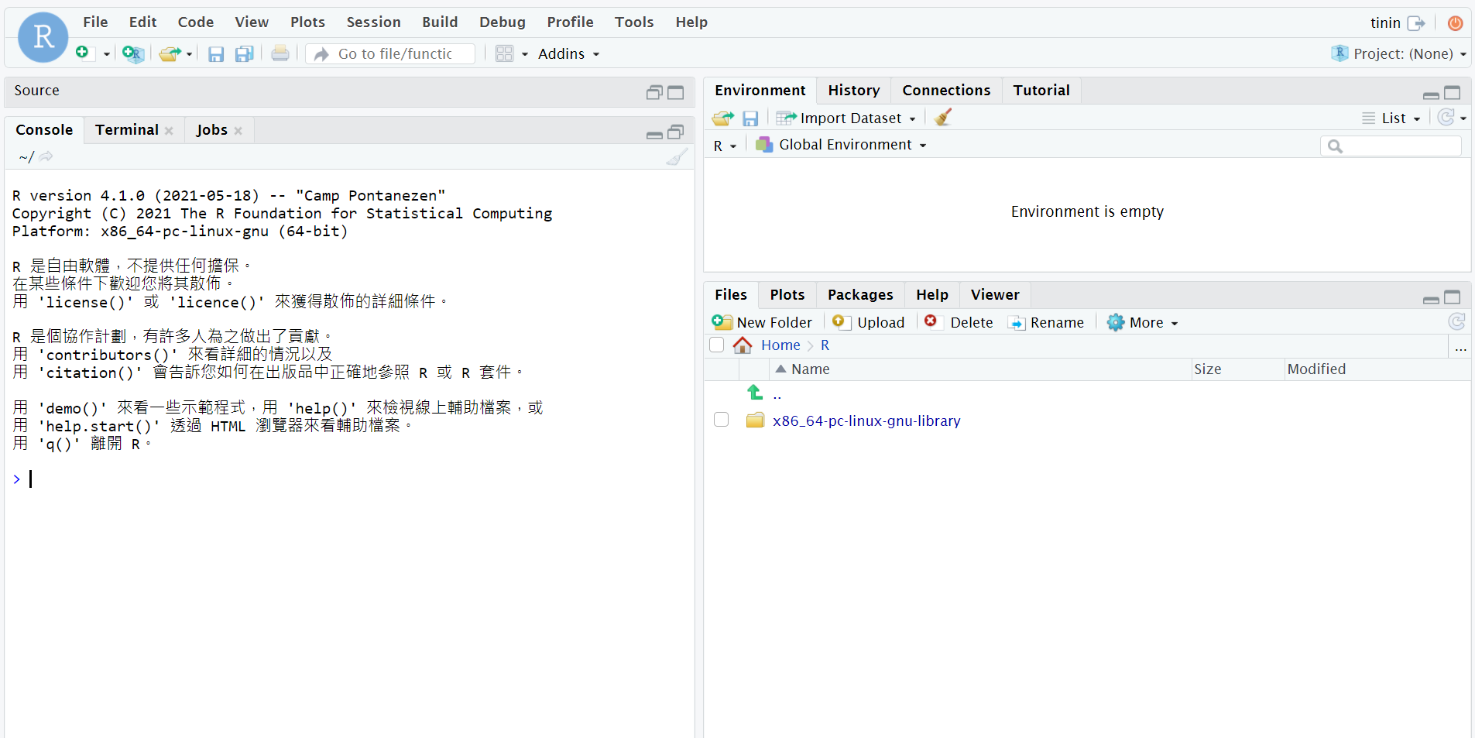
Installation
RStudio requires R 2.11.1 (or higher).
http://cran.rstudio.com/
RStudio download page
http://www.rstudio.com/products/rstudio/download/

Slide 13
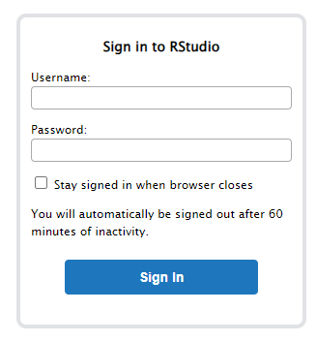
Connect to server
http://140.138.77.70:8787
Username : sID
Password : sID

Slide 14
Connect to server
After Login (same as RStudio Desktop)

Slide 15
Connect to server
Login by Mobile
Open Browser App
http://140.138.77.70:8787

Slide 16
passwd
Changing Password
at least 6 characters
can not too simple
passwd
tinin@class-00:~$ passwd
Changing password for tinin.
(current) UNIX password:
Enter new UNIX password:
Retype new UNIX password:
passwd: password updated successfully tinin@class-00:~$

Slide 17
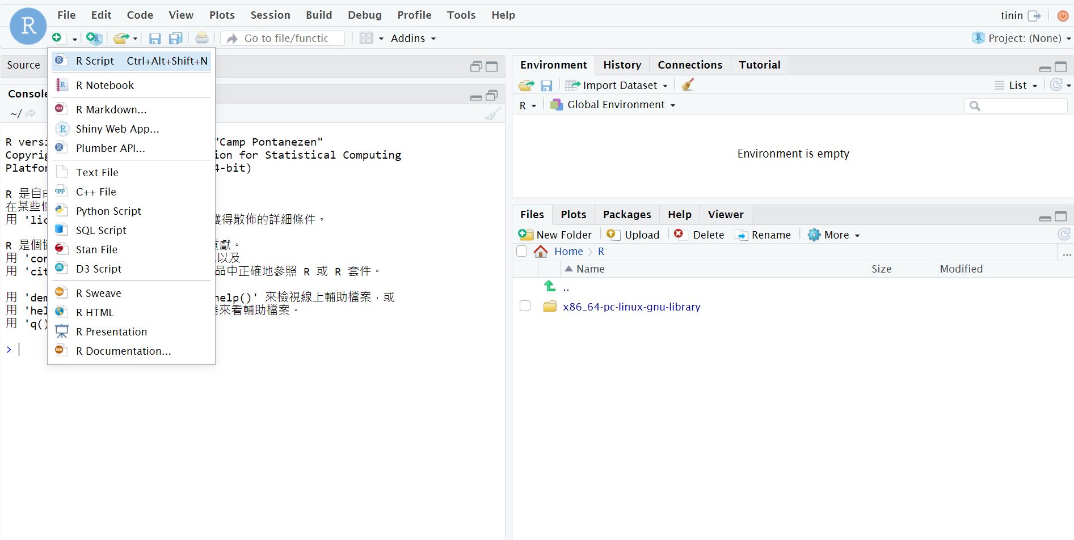
Get ready to RStudio

Slide 18
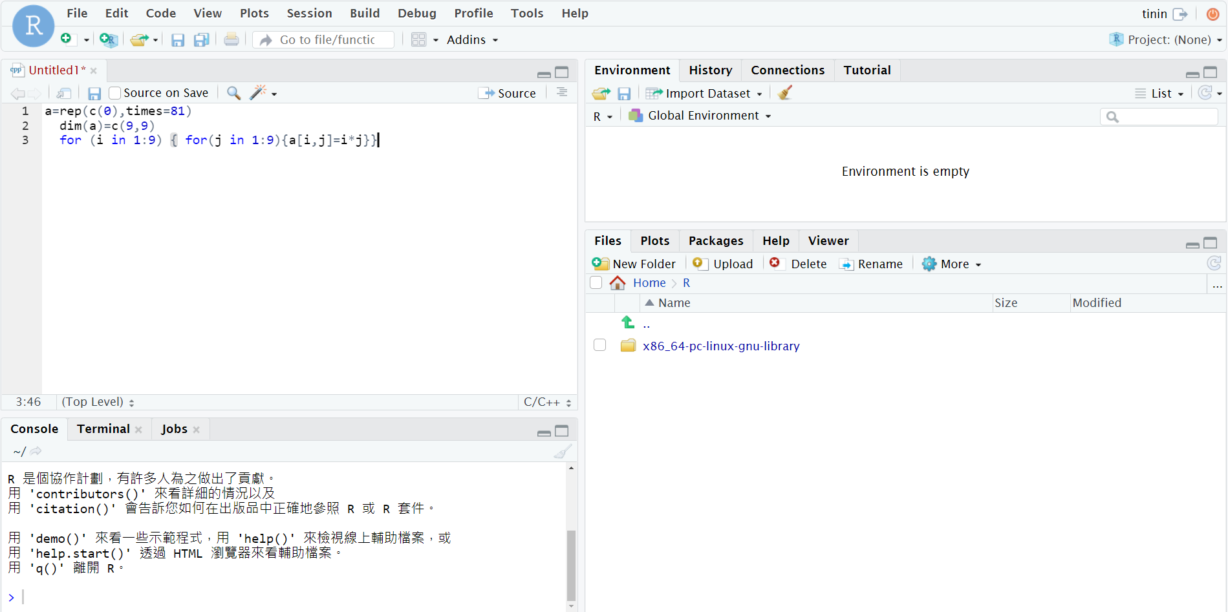
Get ready to RStudio
Ctrl + 1
Ctrl + 2

Slide 19
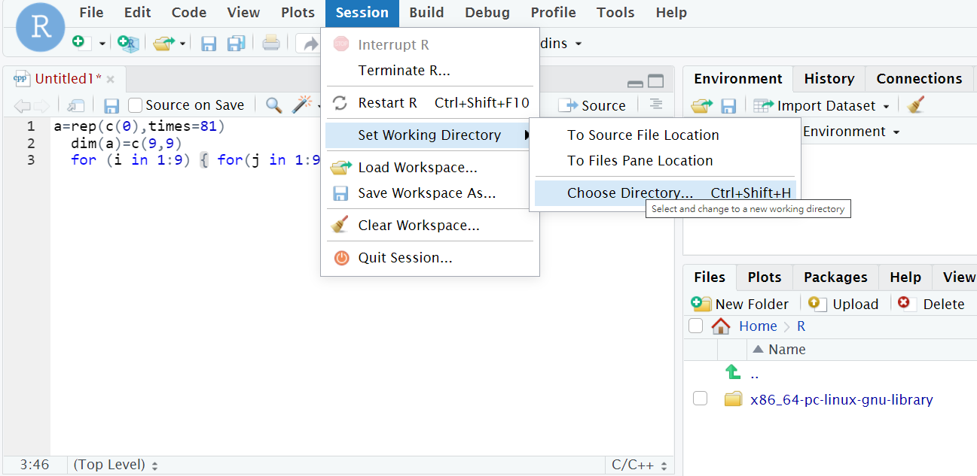
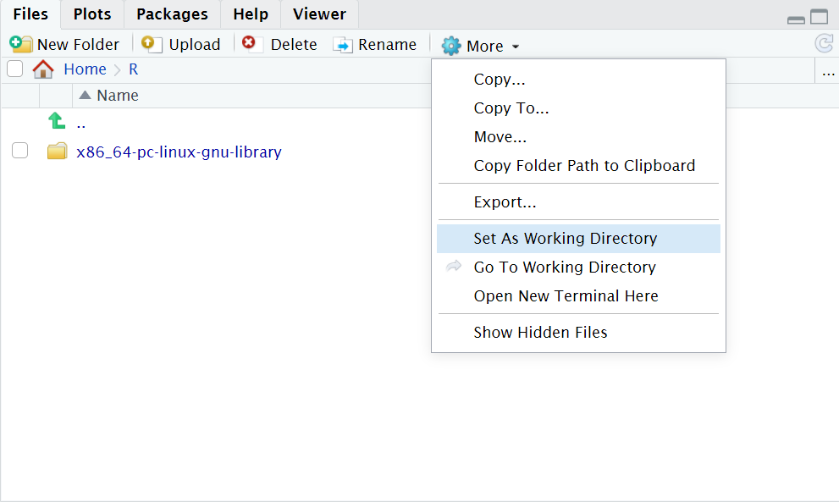
Get ready to RStudio
設定工作目錄(Set Working Directory)
Method 1: setwd("~/")
Method 2 : session -> Set Working Directory -> Choose Directory
Method 3 : files -> More -> Set As Working Directory

Slide 20
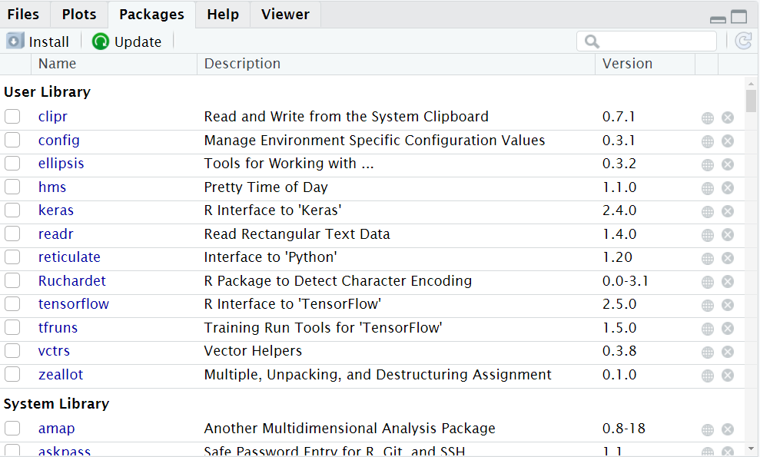
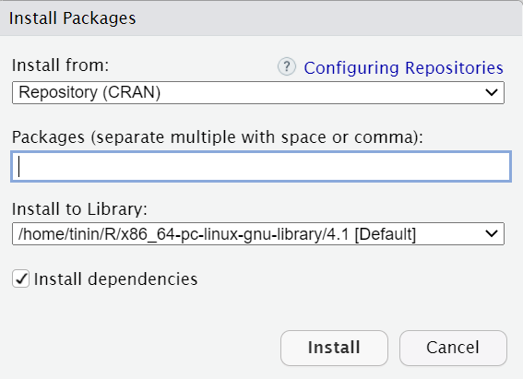
Get ready to RStudio
套件安裝
Method 1 : install.packages("PACKAGENAME")
Method 2: packages -> install -> package name

Slide 21
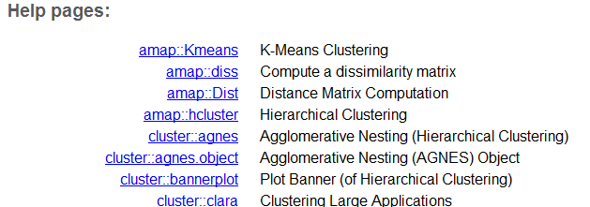
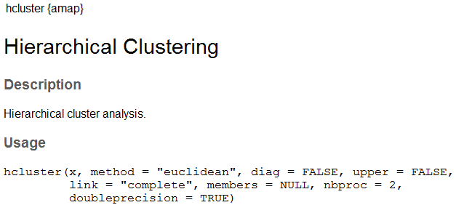
Suggestion step to install packages
Step 1: ??hcluster
Step 2: install.packages("amap")
Step 3: library(amap)
Step 4: ?hcluster/ args(hcluster) / example(hcluster)

Slide 22
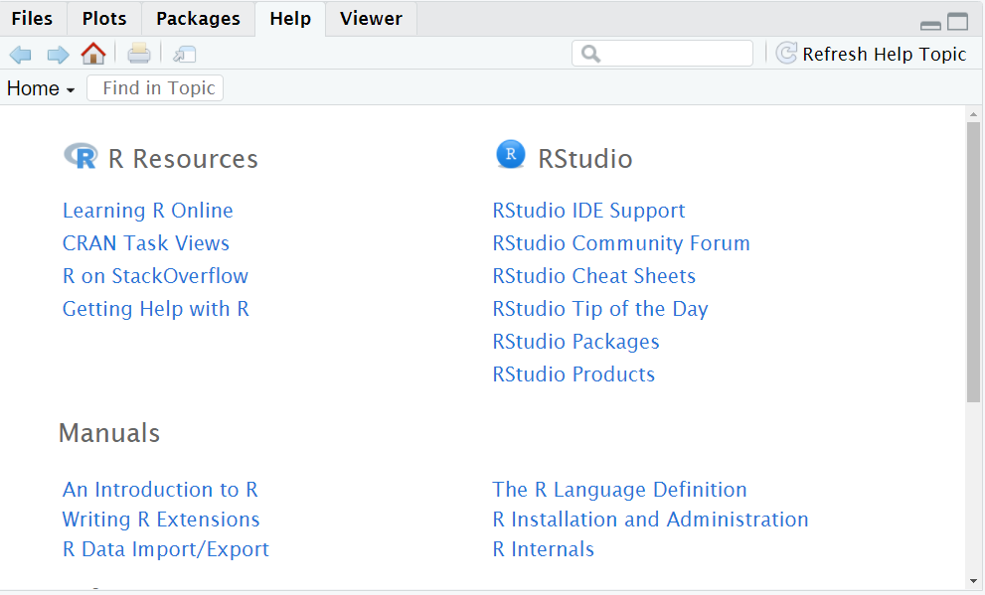
Get ready to RStudio
?plot, help("plot") #知道指令名稱help.search("plot") #不知道指令名稱apropos("plot") #函數名稱中有"plot"字串的所有函數
find("plot") # plot在哪個package
getAnywhere("plot") #plot函數出現在哪些package
args("plot") # 查詢plot參數
Manuals

Slide 23
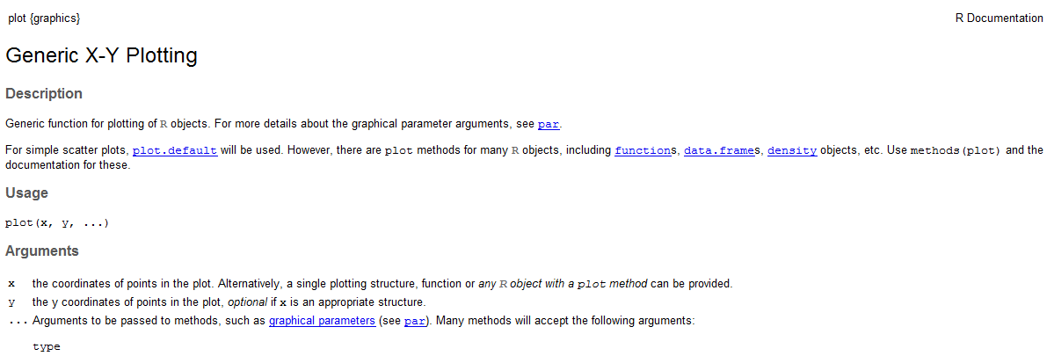
Get ready to RStudio
Manuals

Slide 24
Get ready to RStudio
Description: 摘要說明
Usage: 使用語法
Arguments:參數說明
Details: 完整說明
Value: 輸出項目
References: 參考文件
See Also: 其它相關函式 其它相關函式
Examples: 舉例
args("plot")
example("plot")

Slide 25
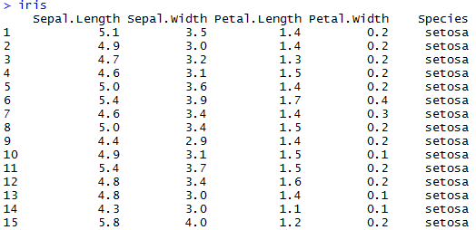
Get ready to RStudio
Arguments
args(agnes)
Necessary arguments, option arguments
Arguments order
Arbitrary order, Must be given arguments’ name
agnes(iris, metric="euclidean",method="single")
By order, do not need arguments’ name
Note : install package "cluster"

Slide 26
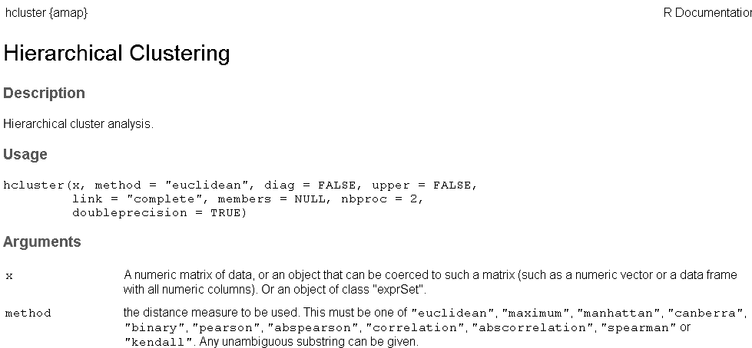
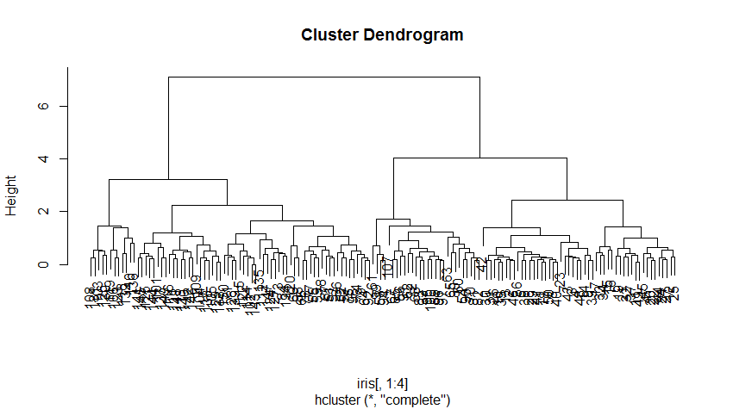
Get ready to RStudio
Arguments
> library(amap)
> a = hcluster(iris[,1:4], method="euclidean",link="complete")
> plot(a)

Slide 27
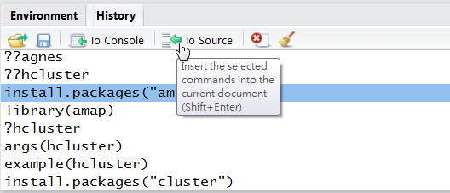
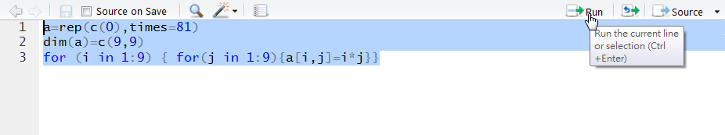
Get ready to RStudio
You may key-in commands directly in R environment or on a R script instead
history() to recall the previous commands
Ctrl+R to run the script

Slide 28
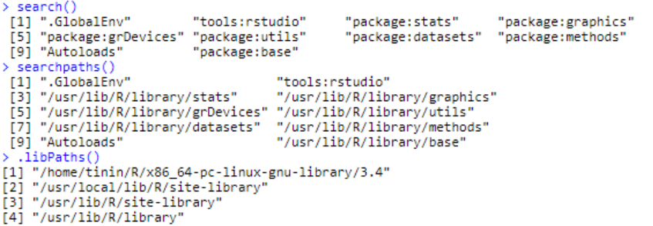
Get ready to RStudio
System information
search() , searchpaths()
Gives a list of attached packages
.libPaths()
gets/sets the library trees within which packages are looked for

Slide 29
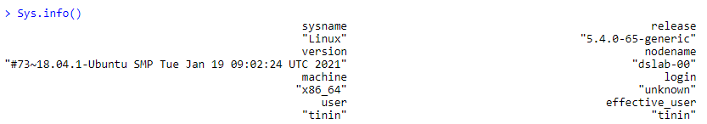
Get ready to RStudio
System information
Sys.info()

Slide 30
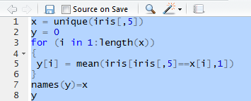
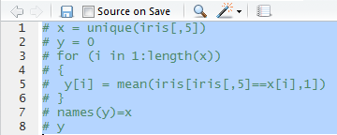
Get ready to RStudio
Comment line
#
Comment lines
Step 1: select
Step 2 : ctrl + shift + c

Slide 31
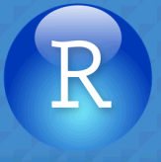
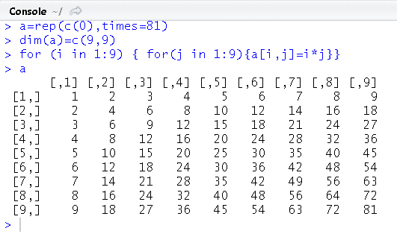
Exercise
Download & install Rstudio / login server
Open RStudio
Open new project
Open R script：example.r
Please check working directory
Execute the script

Slide 32
Basic R Programming

Slide 33
Basic R Programming
R includes objects and function：
object：
3.0
"YZU"
c(2.5, 3.4, 7.1, 0.5)
function：
sqrt(3/4)
exp(3.72)

Slide 34
Basic R Programming- assignment
Variable <- object
a<-2
Variable = object
a=2
object -> Variable
2->a

Slide 35
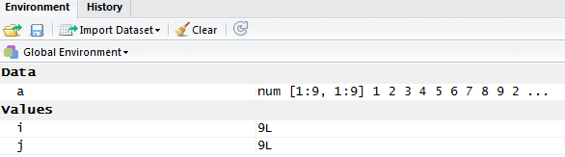
Basic R Programming- Naming
Include A-Z, a-z, 0-9, ".", "_"
Case sensitive
_ can’t located at 1st position
. at 1st position (hidden variable)
List all object
ls(all.names=T)

Slide 36
Basic R Programming- Object
Numeric, Character
a=2
b="abc"
Vector, matrix
x = c(1,2,3)
y = matrix(c(1,2,3,4,5,6),nrow=3,ncol=2)
R function result
function
sum_fn<-function(x,y) { a= x+y}

Slide 37
Some example
> 2+3
[1] 5
> sqrt(3/4)/(1/3-2/pi^2)
[1] 6.626513
> exp(3.72)
[1] 41.26439
> sin(pi)
[1] 1.224606e-16
> log(10)
[1] 2.302585
> log2(10)
[1] 3.321928
> log10(10)
[1] 1

Slide 38
Basic R Programming- operator
> A = array(1:6, c(3, 2))
> A
[,1] [,2]
[1,] 1 4
[2,] 2 5
[3,] 3 6
> B = array(7:8, c(2, 1))
> B
[,1]
[1,] 7
[2,] 8
> A %*% B
[,1]
[1,] 39
[2,] 54
[3,] 69
Basic operator
+, -, *, /
^ (power)
%%(remainder)
%/% (quotient)
%*%(matrix multiplication,
inner product)
t(transpose)
%o%(outer product)
> 2^3
[1] 8
> 35 %% 4
[1] 3
> 35 %/% 4
[1] 8

Slide 39
Basic R Programming- operator
Logical operator
| (or, each position)
|| (or, first position)
& (and, each position)
&& (and, first position)
TRUE(T), FALSE(F)
<, >, <=, >=, !=, ==
> x=c(1,2)
> (x==1)|(x==3)
[1] TRUE FALSE
> (x==1)||(x==3)
[1] TRUE
> a=2
> b=3
> c=a=b
> c
[1] 3
> a=2
> b=3
> c=a==b
> c
[1] FALSE

Slide 40
Basic R Programming- keywords
keywords
# (Comment)
NA, NaN, is.na, is.nan
pi (π)
exp (nature number)

Slide 41
Basic R Programming- Basic statistics function
Basic statistics function
log (ln)
log2
log10
abs(absolute value)
ceiling
floor

Slide 42
Basic R Programming- Basic statistics function
Basic statistics function
min
max
mean
median
sum
var(variance)
sd(standard deviation)
quantile
summary
> x=c(1,3,5,7,9)
> max(x)
[1] 9
> min(x)
[1] 1
> mean(x)
[1] 5
> median(x)
[1] 5
> sum(x)
[1] 25
> var(x)
[1] 10
> sd(x)
[1] 3.162278
> quantile(x)
0% 25% 50% 75% 100%
1 3 5 7 9
> summary(x)
Min. 1st Qu. Median Mean 3rd Qu. Max.
1 3 5 5 7 9

Slide 43
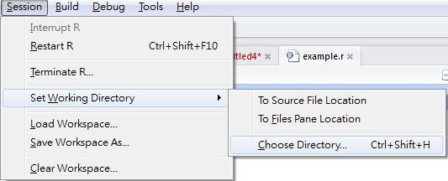
Exercise
Please calculate min, max, mean, median, variance and standard deviation score in "score_exercise.csv"
Hint :
Please check working directory and upload file
x=read.csv("score_exercise.csv",sep=",",header=T)
score=x[,2]

Slide 44
Basic R Programming- data type
Numeric
Integer
-2^109 ~ 2^109
x=3
Real number
X=3.14
Character
x="3"
Complex number
x=1+2i

Slide 45
Basic R Programming- data type
Logical
x=TRUE
x=T
factor(x, ordered=F)
x=factor( c("a", "b", "c"), ordered=T)
Date
as.Date(x, format="%Y-%m-%d")
x=as.Date("2021-02-25")
as.POSIXlt("Jun 9 14:27:52 2021", format="%h %d %H:%M:%S %Y")
> x=as.Date("2021-02-25")
> months(x)
[1] "February"
> weekdays(x)
[1] "Thursday"

Slide 46
Basic R Programming- data type
Missing data
NA (is.na)
NaN(is.nan, is.na)
Vectors
Matrices
Lists
Data frames

Slide 47
Basic R Programming- data type
Data type transfer
is.* 是否為…
as.* (強迫)使為…
> x="abc"
> is.character(x)
[1] TRUE
> is.integer(x)
[1] FALSE
> a=as.numeric(x)
Warning message:
NAs introduced by coercion
> a
[1] NA
> x="abc"
> mode(x)
[1] "character"
> x=1
> mode(x)
[1] "numeric"

Slide 48
Basic R Programming- data type
Data type transfer
Date <-> Character
> x = as.Date("2021/02/25")
> a = as.character(x)
> a
[1] "2021-02-25"
> as.numeric(substring(a,1,4))#year
[1] 2021
> as.numeric(substring(a,6,7))#month
[1] 2
> as.numeric(substring(a,9,10))#day
[1] 25

Slide 49
Basic R Programming- data type
Date operator
> x = as.Date("2022/01/19")
> x = x+1 # add 1 day
> x
[1] "2022-01-20"
> y = as.Date("2023/01/20")
> a = difftime(y,x,unit="days")
> a
Time difference of 365 days
> as.integer(a)
[1] 365
> age = as.integer(difftime(Sys.Date(),"2001-01-01",unit="days") /365.25)
> age
[1] 21

Slide 50
Basic R Programming- vector(向量)
vector: must have the same mode(numeric, character, etc.)
> x=c(1,1,1,2,2,3)
> x
[1] 1 1 1 2 2 3
> names(x)=c("A","B","C","D","E","F")
> x
A B C D E F
1 1 1 2 2 3
> x[4]
D
2
> x=unname(x)
> x
[1] 1 1 1 2 2 3
> x[2:4]
[1] 1 1 2

Slide 51
Basic R Programming- vector(向量)
operator
> x=c(1,2,3,4)
> y=c(5,6,7,8)
> x*y
[1] 5 12 21 32
> y=c(5,6)
> x*y
[1] 5 12 15 24
> y=c(5,6,7)
> x*y
[1] 5 12 21 20
Warning message:
In x * y : longer object length is not a multiple of shorter object length
> y=2*x+1
> y
[1] 3 5 7 9

Slide 52
Basic R Programming- vector(向量)
> x=c(3,1,2,1,1,4)
> names(x)=c("A","B","C","D","E","F")
> x[x==1]
B D E
1 1 1
> which(x==1)
B D E
2 4 5
> unique(x)
[1] 3 1 2 4
> length(x)
[1] 6
> sort(x)
B D E C A F
1 1 1 2 3 4
> order(x)
[1] 2 4 5 3 1 6
> order(x, decreasing=T)
[1] 6 1 3 2 4 5

Slide 53
Exercise
Please calculate the final score of each student in "finalscore_exercise.csv"
Final score = 0.3 * HW + 0.3 * Midterm + 0.4 * final exam
How many students fail the course? Which one?
Hint :
Please check working directory
x=read.csv("finalscore_exercise.csv",sep=",",header=T)

Slide 54
Basic R Programming- vector(向量)
Generate sequences
seq()
rep()
> x=1:5
> x
[1] 1 2 3 4 5
> x=seq(0,10,by=2)
> x
[1] 0 2 4 6 8 10
> x=seq(length=6,from=0,by=1)
> x
[1] 0 1 2 3 4 5
> x=1:3
> y=rep(x,times=2)
> y
[1] 1 2 3 1 2 3
> y=rep(x,each=2)
> y
[1] 1 1 2 2 3 3

Slide 55
Basic R Programming- vector(向量)
character
x=c("a","b","c")
escape sequences
\n : newline
\t : tab
\b : backspace
\" : quotation mark
\\ : backslash

Slide 56
Basic R Programming- vector(向量)
Vector concatenate
> x=c(1,2,3,4)
> y=paste("a",x,sep=":")
> y
[1] "a:1" "a:2" "a:3" "a:4"
> y=paste("a",x,sep="")
> y
[1] "a1" "a2" "a3" "a4"
> x=c(x,5:7)
> x
[1] 1 2 3 4 5 6 7
> x=c(x,c(8,9))
> x
[1] 1 2 3 4 5 6 7 8 9
> a=c("X","Y","Z")
> b=paste(a,collapse = "_")
> b
[1] "X_Y_Z"

Slide 57
Basic R Programming- vector(向量)
NA to zero
> x=c("4","2","8","A","B","C")
> mode(x)
[1] "character"
> y = as.integer(x)
> y
[1] 4 2 8 NA NA NA
> mode(y)
[1] "numeric"
> z = na.omit(y)
> z
[1] 4 2 8
attr(,"na.action")
[1] 4 5 6
attr(,"class")
[1] "omit" > y[is.na(y)] = 0
> y
[1] 4 2 8 0 0 0

Slide 58
Basic R Programming- Basic statistics function
Basic statistics function
na.rm = T
> x=c("1","2","3","A","B","C")
> mode(x)
[1] "character"
> y = as.integer(x)
> y
[1] 1 2 3 NA NA NA
> mean(y)
[1] NA
> mean(y,na.rm=T)
[1] 2

Slide 59
Basic R Programming - matrix(矩陣)
matrix, array : must have the same mode(numeric, character, etc.)
> x = matrix(1:6,nrow=2,ncol=3)
> x
[,1] [,2] [,3]
[1,] 1 3 5
[2,] 2 4 6
> y = matrix(1:6,nrow=2,ncol=3,byrow=T)
> y
[,1] [,2] [,3]
[1,] 1 2 3
[2,] 4 5 6

Slide 60
Basic R Programming - matrix(矩陣)
> x=1:6
> dim(x)=c(2,3)
> x
[,1] [,2] [,3]
[1,] 1 3 5
[2,] 2 4 6
> dim(x)=c(3,2)
> x
[,1] [,2]
[1,] 1 4
[2,] 2 5
[3,] 3 6
> t(x)
[,1] [,2] [,3]
[1,] 1 2 3
[2,] 4 5 6

Slide 61
Basic R Programming - matrix(矩陣)
Get element
> x = matrix(1:6,nrow=2,ncol=3,byrow=T)
> x
[,1] [,2] [,3]
[1,] 1 2 3
[2,] 4 5 6
> x[2,2]
[1] 5
> x[2,]
[1] 4 5 6
> x[2,c(1,3)]
[1] 4 6
> x[1:2,c(1,3)]
[,1] [,2]
[1,] 1 3
[2,] 4 6

Slide 62
Basic R Programming - matrix(矩陣)
name
> x = matrix(1:6,nrow=2,ncol=3,byrow=T)
> x
[,1] [,2] [,3]
[1,] 1 2 3
[2,] 4 5 6
> rownames(x) = paste("r",1:nrow(x), sep="")
> colnames(x) = paste("c",1:ncol(x), sep="")
> x
c1 c2 c3
r1 1 2 3
r2 4 5 6
> x = unname(x)
> x
[,1] [,2] [,3]
[1,] 1 2 3
[2,] 4 5 6

Slide 63
Basic R Programming - matrix(矩陣)
> x = 1:4
> dim(x)=c(2,2)
> x
[,1] [,2]
[1,] 1 3
[2,] 2 4
> x+x
[,1] [,2]
[1,] 2 6
[2,] 4 8
> x%*%x
[,1] [,2]
[1,] 7 15
[2,] 10 22
> t(x)
[,1] [,2]
[1,] 1 2
[2,] 3 4
> solve(x)
[,1] [,2]
[1,] -2 1.5
[2,] 1 -0.5
> det(x)
[1] -2
operator
+, -
%*%
matrix multiplication
t
transport
solve
inverse
det
determinant

Slide 64
Basic R Programming - matrix(矩陣)
Matrix concatenate
cbind(ARRAY1,ARRAY2)
rbind(ARRAY1,ARRAY2)
> x= matrix(1:6,nrow=2,ncol=3,byrow=T)
> y= matrix(7:12,nrow=2,ncol=3,byrow=T)
> cbind(x,y)
[,1] [,2] [,3] [,4] [,5] [,6]
[1,] 1 2 3 7 8 9
[2,] 4 5 6 10 11 12
> rbind(x,y)
[,1] [,2] [,3]
[1,] 1 2 3
[2,] 4 5 6
[3,] 7 8 9
[4,] 10 11 12
x
y
x
y

Slide 65
Exercise
Multiplication table(九九乘法表)
Hint : Matrix multiplication

Slide 66
Basic R Programming - matrix(矩陣)
apply (X, MARGIN, FUN,…)
Returns a vector or array or list of values obtained by applying a function to margins of an array or matrix.
X: dataset
MARGIN : a vector giving the subscripts which the function will be applied over
1 indicates rows, 2 indicates columns
FUN : function
… : optional arguments to FUN
e.g: na.rm=T
> apply (iris[1:4],2,mean)
Sepal.Length Sepal.Width Petal.Length Petal.Width
5.843333 3.057333 3.758000 1.199333

Slide 67
Exercise
Please calculate the average and standard deviation score of HW, midterm and final exam in "finalscore_exercise.csv"
Please calculate the average and standard deviation score of each student in "finalscore_exercise.csv"
Hint :
Please check working directory
x=read.csv("finalscore_exercise.csv",sep=",",header=T)
Use apply

Slide 68
Exercise
Please calculate the average PM2.5 concentration of every day.
Hint :
Please check working directory
x=read.csv("PM25.csv",sep=",",header=T)
x[,3:26]
Use apply
na.rm=T

Slide 69
Basic R Programming - factor(因子)
factor is used to encode a vector as a factor (the terms ‘category’ and ‘enumerated type’ are also used for factors)
> x = c(1, 2, 4, 3, 1, 2, 3, 4, 1)
> factor(x)
[1] 1 2 4 3 1 2 3 4 1
Levels: 1 2 3 4
> factor(x, labels = c("A", "B", "C", "D")) # set level name
[1] A B D C A B C D A
Levels: A B C D
> factor(x, ordered = TRUE)
[1] 1 2 4 3 1 2 3 4 1
Levels: 1 < 2 < 3 < 4

Slide 70
Basic R Programming - factor(因子)
> factor(c(1, 2, 1, NA, 2), exclude = NA)
[1] 1 2 1 <NA> 2
Levels: 1 2
> factor(c(1, 2, 1, NA, 2), exclude = 2)
[1] 1 <NA> 1 <NA> <NA>
Levels: 1 <NA>
> factor(c(1, 2, 1, NA, 2), exclude = NULL)
[1] 1 2 1 <NA> 2
Levels: 1 2 <NA>

Slide 71
Basic R Programming - list(列表)
list：The data type can different
> x = list(A=c(1,2,3), B=matrix(c("a", "b", "c",
+ "d"),nrow=2,ncol=2))
> x
$A
[1] 1 2 3
$B
[,1] [,2]
[1,] "a" "c"
[2,] "b" "d"
> names(x)
[1] "A" "B"
> length(x)
[1] 2
> x$A[2]
[1] 2

Slide 72
Basic R Programming - list(列表)
> unname(x)
[[1]]
[1] 1 2 3
[[2]]
[,1] [,2]
[1,] "a" "c"
[2,] "b" "d"

Slide 73
Basic R Programming - list(列表)
List concatenate
x = list(A=c(1,2,3), B=matrix(c("a", "b", "c",
+ "d"),nrow=2,ncol=2))
> y=list(C=as.Date("2012-12-20"),D=1+2i)
> c(x,y)
$A
[1] 1 2 3
$B
[,1] [,2]
[1,] "a" "c"
[2,] "b" "d"
$C
[1] "2012-12-20"
$D
[1] 1+2i

Slide 74
Basic R Programming -data frame(資料欄)
data frame :must have the same mode in each column
> y=data.frame(WD=c(2,3), ID=c("tinin","bp"),
+ Date=as.Date(c("2016-02-23","2016-02-24")))
> y
WD ID Date
1 2 tinin 2016-02-23
3 bp 2016-02-24
> y$ID
[1] tinin bp
Levels: bp tinin
> y$ID[2]
[1] bp
Levels: bp tinin
> y[,c(2,3)]
ID Date
1 tinin 2016-02-23
2 bp 2016-02-24

Slide 75
Basic R Programming -data frame(資料欄)
Data frame concatenate
cbind(DATA FRAME1, DATA FRAME2)
rbind(DATA FRAME1, DATA FRAME2)
> y=data.frame(WD=c(2,3), ID=c("tinin","bp"),
+ Date=as.Date(c("2016-02-23","2016-02-24")))
> z=data.frame(PHONE=c("0910","0911"))
> cbind(y,z)
WD ID Date PHONE
1 2 tinin 2016-02-23 0910
2 3 bp 2016-02-24 0911
> x=data.frame(WD=4,
+ ID="lee",Date=as.Date("2016-02-25"))
> rbind(y,x)
WD ID Date
1 2 tinin 2016-02-23
2 3 bp 2016-02-24
3 4 lee 2016-02-25

Slide 76
Basic R Programming -data frame(資料欄)
Sort
> w = rbind(y,x)
> w
WD ID Date
1 2 tinin 2016-02-23
2 3 bp 2016-02-24
3 4 lee 2016-02-25
> w = w[order(w$WD,decreasing = TRUE),]
> w
WD ID Date
3 4 lee 2016-02-25
2 3 bp 2016-02-24
1 2 tinin 2016-02-23

Slide 77
Exercise
Data
x=read.csv("Taiwan.csv",header=T)
Q1 : How many residents in Taiwan?
Q2: Calculate the population density of each county
Q3: Sort the data in descending order by population density
Hint:
colnames(x)[4] = "density"
order(), ?order
x[order(…),]
Q4: How many counties have more than 2,000,000 residents？Which county？
Hint : which(), length()
Hint : x[which(…),]

Slide 78
Basic R Programming -data frame(資料欄)
Merge
Merge two data frames by common columns or row names, or do other versions of database join operations
> a=data.frame(WD=c(2,3,4), ID=c("tinin", "bp","lee"),
+ Date=as.Date(c("2016-02-23","2016-02-24","2016-02-25")),
+ PHONE=c("0910","0955","0933"))
> b=data.frame(PHONE=c("0910","0955","0987","0966"),
+ NAME=c("CHT","FET","TM","PHS"))
> a
WD ID Date PHONE
1 2 tinin 2016-02-23 0910
2 3 bp 2016-02-24 0955
3 4 lee 2016-02-25 0933
> b
PHONE NAME
1 0910 CHT
2 0955 FET
3 0987 TM
4 0966 PHS

Slide 79
Basic R Programming -data frame(資料欄)
> merge(x=a,y=b, by="PHONE",all=TRUE) #outer join
PHONE WD ID Date NAME
1 0910 2 tinin 2016-02-23 CHT
2 0933 4 lee 2016-02-25 <NA>
3 0955 3 bp 2016-02-24 FET
4 0966 NA <NA> <NA> PHS
5 0987 NA <NA> <NA> TM
> merge(x=a,y=b, by="PHONE",all.x=TRUE) #left join
PHONE WD ID Date NAME
1 0910 2 tinin 2016-02-23 CHT
2 0933 4 lee 2016-02-25 <NA>
3 0955 3 bp 2016-02-24 FET

Slide 80
Basic R Programming -data frame(資料欄)
> merge(x=a,y=b, by="PHONE",all.y=TRUE) #right join
PHONE WD ID Date NAME
1 0910 2 tinin 2016-02-23 CHT
2 0955 3 bp 2016-02-24 FET
3 0966 NA <NA> <NA> PHS
4 0987 NA <NA> <NA> TM
> merge(x=a,y=b, by="PHONE",all=FALSE) #inner join
PHONE WD ID Date NAME
1 0910 2 tinin 2016-02-23 CHT
2 0955 3 bp 2016-02-24 FET

Slide 81
Basic R Programming -data frame(資料欄)
> a=data.frame(WD=c(2,3,4), ID=c("tinin", "bp","lee"),
+ Date=as.Date(c("2016-02-23","2016-02-24","2016-02-25")),
+ PHONE=c("0910","0955","0933"))
> b=data.frame(NUM=c("0910","0955","0987","0966"),
+ NAME=c("CHT","FET","TM","PHS"))
> merge(a,b, by.x="PHONE", by.y="NUM", all=FALSE) #inner join
PHONE WD ID Date NAME
1 0910 2 tinin 2016-02-23 CHT
2 0955 3 bp 2016-02-24 FET

Slide 82
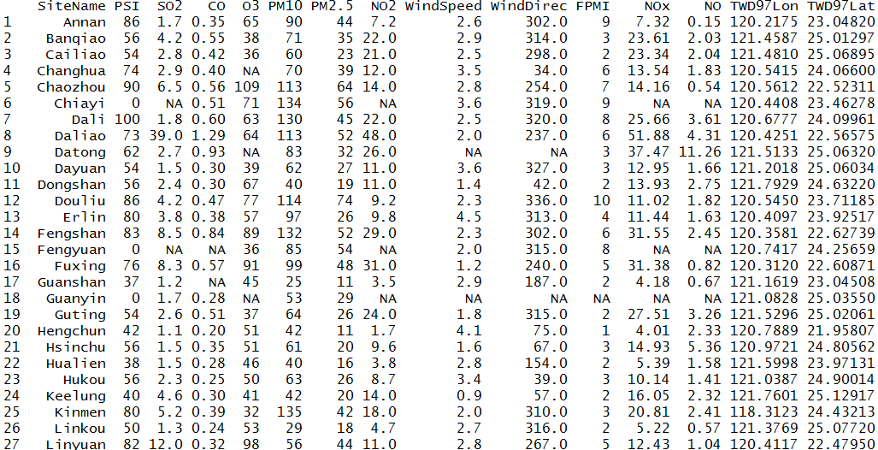
Exercise
Merge two datasets, AQX.csv and AQXsite.csv, by ‘SiteName’

Slide 83
Control Structures

Slide 84
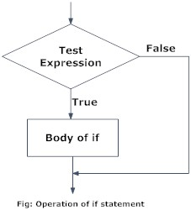
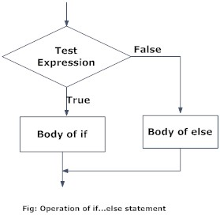
Control Structures - if
if (cond) expr
if (cond) expr1 else expr2
> a=2
> if (a %% 2 == 1) print ("odd") else print ("even")
[1] "even"

Slide 85
Control Structures - if
> score = 60
> if (score >= 80){
+ print("A")
+ } else if (score >= 70 && score < 80){
+ print("B")
+ } else if (score >= 60 && score < 70){
+ print("C")
+ } else{
+ print("D")
+ }
[1] "C"

Slide 86
Control Structures - if
> x = 1:10
> y = ifelse(x>5,"T","F")
> y
[1] "F" "F" "F" "F" "F" "T" "T" "T" "T" "T"

Slide 87
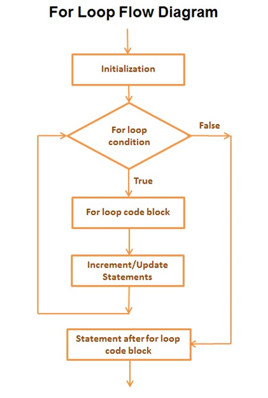
Control Structures - for
for (var in seq) expr
var : variable
seq : vector
> sum=0
> for (i in 1:20){sum = sum + i}
> sum
[1] 210

Slide 88
Control Structures - for
> print(paste("The year is", 2010))
[1] "The year is 2010"
> print(paste("The year is", 2011))
[1] "The year is 2011"
> print(paste("The year is", 2012))
[1] "The year is 2012"
> print(paste("The year is", 2013))
[1] "The year is 2013"
> print(paste("The year is", 2014))
[1] "The year is 2014"
> print(paste("The year is", 2015))
[1] "The year is 2015"
for (var in seq) expr
var : variable
seq : vector
> for (i in 2010:2015){
+ print(paste("The year is", i))
+ }
[1] "The year is 2010"
[1] "The year is 2011"
[1] "The year is 2012"
[1] "The year is 2013"
[1] "The year is 2014"
[1] "The year is 2015"

Slide 89
Control Structures - for
for (var in seq) expr
var : variable
seq : vector
> sum=0
> for (i in 1:20){sum = sum + i}
> sum
[1] 210
> x = seq(2,20,by=2)
> sum = 0
> for (i in x)
+ {
+ sum = sum +i
+ }
> sum
[1] 110

Slide 90
Control Structures - for
Example : Multiplication table
> a=rep(c(0),times=81)
> dim(a)=c(9,9)
> for (i in 1:9) {
+ for(j in 1:9){
+ a[i,j]=i*j}}

Slide 91

Exercise
Pascal Triangle

Slide 92
Control Structures - for
> out = rep(0,4)
> for (i in 1:4)
+ {
+ out[i] = mean(iris[,i])
+ }
> names(out) = colnames(iris[,1:4])
> out
Sepal.Length Sepal.Width Petal.Length Petal.Width
5.843333 3.057333 3.758000 1.199333

Slide 93
Control Structures - for
> x = unique(iris[,5])
> y = 0
> for (i in x)
+ {
+ y[i] = mean(iris[iris[,5]==i,1])
+ }
> y
setosa versicolor virginica
0.000 5.006 5.936 6.588
> x = unique(iris[,5])
> y = 0
> for (i in 1:length(x))
+ {
+ y[i] = mean(iris[iris[,5]==x[i],1])
+ }
> names(y)=x
> y
setosa versicolor virginica
5.006 5.936 6.588

Slide 94

Exercise
Calculate the average of Sepal.Length, Sepal.Width, Petal.Length and Petal.Width of each species in IRIS dataset.

Slide 95

Exercise
Calculate the average concentration of NO2, PM10, PM2.5, O3 and SO2 of each station.
Data:
x=read.csv("AirPollution.csv",header=T)

Slide 96
Control Structures - repeat
repeat expr_repeat
break statement is the only way to come out of the repeat loop
> sum=0
> i=1
> repeat{
+ sum=sum+i
+ i=i+1
+ if(i>20)break
+ }
> sum
[1] 210

Slide 97
Control Structures - while
while (cond) expr
> sum=0
> i=1
> while(i<=20){
+ sum=sum+i
+ i=i+1
+ }
> sum
[1] 210

Slide 98
Control Structures – next & break
next
halts the processing of the current iteration and advances the looping index
Like continue in C++
break
breaks out of a loop
> for (i in 1:5) { if (i==3) next else print(i)}
[1] 1
[1] 2
[1] 4
[1] 5
> for (i in 1:5) { if (i==3) break else print(i)}
[1] 1
[1] 2

Slide 99
Function

Slide 100
Function
myfunction <- function(arg1, arg2, ... ){ statements return(object) }
> sum_test<-function(x,y){
+ z=x+y
+ return(z)
}
> sum_test(2,3)
[1] 5
> z
Error: object ‘z' not found

Slide 101
Function & apply
> multi<-function(x)
+ {
+ result=1
+ for (i in 1:length(x))
+ {
+ result = result * x[i]
+ }
+ return(result)
+ }
> apply(iris[,1:4],1,multi)

Slide 102
recursive
> fac<-function(x){
+ if(x==1) return(1)
+ return (x*fac(x-1))
+ }
> fac(7)
[1] 5040

Slide 103
recursive
fib<-function(x){
+ if(x==0) return(0)
+ if(x==1) return(1)
+ return (fib(x-1)+fib(x-2))
+ }
> fib(7)
[1] 13

Slide 104
File

Slide 105
File - read table / read csv
> x=read.table("load_file.csv", header=T, sep=",",
+ colClasses=c("numeric","character","Date"))
> x
WD ID Date
1 2 tinin 2016-02-23
2 3 bp 2016-02-24
3 4 lee 2016-02-25
> x[2,]
WD ID Date
2 3 bp 2016-02-24
> x[,2]
[1] "tinin" "bp" "lee"
> colnames(x)
[1] "WD" "ID" "Date"

Slide 106
File – CSV (from web)
#> install.packages("RCurl")
> library(RCurl)
> url = URLencode("https://data.epa.gov.tw/api/v1/aqx_p_304?limit=1000&api_key=9be7b239-557b-4c10-9775-78cadfc555e9&format=csv")
> x = readLines(url,encoding="UTF-8")
> col = unlist(strsplit(x[1],split=","))
> data = array(0,c(length(x)-1,length(col)))
> for (i in 2:length(x))
+ {
+ k = i-1
+ tmp=unlist(strsplit(x[i] ,split = ","))
+ for (j in 1:length(tmp))
+ {
+ data[k,j]=tmp[j]
+ }
+}
> colnames(data)=col
> rownames(data)=data[,1]

Slide 107
File - scan (read file)
> x=scan("load_file_scan.csv", what=list(numeric(),
+ character(), character()),sep=",")
Read 3 records
> x
[[1]]
[1] 2 3 4
[[2]]
[1] "tinin" "bp" "lee"
[[3]]
[1] "2016/2/23" "2016/2/24" "2016/2/25"

Slide 108
File –XLSX
> install.packages("xlsx")
> library(xlsx)
> x=read.xlsx("PM25.xlsx",sheetName="PM25")

Slide 109
File - XML
#> install.packages("XML")
> library(XML)
# From Web
> url = "http://140.138.77.210/course/AQX.xml"
> x = xmlParse(url, encoding = "utf8")
> xmlfiles = xmlRoot(x)
> y = xmlToDataFrame(xmlfiles)
# From File
> x = xmlParse("AQX.xml", encoding = "utf8")
> xmlfiles = xmlRoot(x)
> y = xmlToDataFrame(xmlfiles)

Slide 110
File - JSON
#> install.packages("jsonlite")
> library(jsonlite)
# From Web
> url = "http://opendata.epa.gov.tw/ws/Data/AQI/?$format=json"
> x = fromJSON(url,flatten = TRUE)
# From File
> x = fromJSON("AQX.json",flatten = TRUE)

Slide 111

File - cat & write
> x=matrix(4:9,2,3)
> x
[,1] [,2] [,3]
[1,] 4 6 8
[2,] 5 7 9
> cat(1:3, sep="\t", file="out.txt")
> cat("\n",file="out.txt",append=T)
> write( x, ncolumns=3, file="out.txt",append=T)

Slide 112
File - write table
> a=data.frame(WD=c(2,3,4), ID=c("tinin","bp","lee"),
+ Date=as.Date(c("2016-02-23","2016-02-24","2016-02-25")),
+ PHONE=c("0910","0955","0933"))
> write.table(a, file="out.csv", row.names=F,
+ col.names=T, sep=",")

Slide 113
File - sink (write file)
> sink(file="out.txt") #open
> x=read.table("load_file.csv", header=T, sep=",",
+ colClasses=c("numeric","character","Date"))
> x
> x
> sink() #close

Slide 114
Convert file type
# xlsx to csv
> x=read.xlsx("AQX.xlsx",sheetName="AQX")
> write.table(x,file="out.csv",col.names = T,row.names = F,sep=",")
# xml to csv
> x = xmlParse("AQX.xml", encoding = "utf8")
> xmlfiles = xmlRoot(x)
> y = xmlToDataFrame(xmlfiles)
> write.table(y,file="out.csv",col.names = T,row.names = F,sep=",")
# json to csv
> x = fromJSON("AQX.json",flatten = TRUE)
> write.table(x,file="out.csv",col.names = T,row.names = F,sep=",")

Slide 115
Exercise
Convert a lot of xlsx files to csv
Hint :
filelist = list.files(path = "AQData")
for (i in 1:length(filelist))

Slide 116
dplyr

Slide 117
dplyr
Like SQL command
Filter (like where), select, arrange(like order by), mutate (add column), group_by
Inner join, left join

Slide 118
dplyr
Filter data
#> install.packages("dplyr")
> library("dplyr")
> titanic = data.frame(Titanic)
> titanic[titanic$Sex=="Male" & titanic$Age=="Adult", ]
# use filter
> filter(titanic, Sex == "Male" & Age== "Adult") #AND
> filter(titanic, Sex == "Male" | Age== "Adult") #OR
# find class in 1st and Crew
> filter(titanic, Class %in% c('1st', 'Crew'))

Slide 119
dplyr
select column
> titanic = data.frame(Titanic)
> titanic[, c("Sex","Age")]
# select column "Sex" and "Age"
> select(titanic, Sex, Age)
# select column from "Sex" to "Survived"
> select(titanic, Sex:Survived)
# column name contains "S"
> select(titanic, contains("S"))

Slide 120
dplyr
then function
%>% (like pipe | in linux)
> filter(select(titanic, Sex, Class, Age), Age == "Child")
# then function
> titanic %>% select(Sex, Class, Age) %>% filter(Age == "Child")

Slide 121
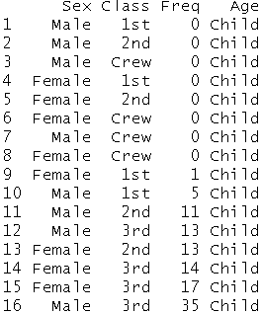
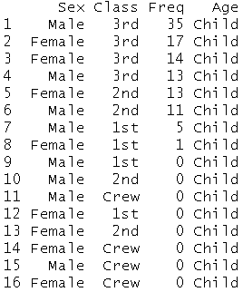
dplyr
Arrange
Like order by
> titanic %>%
+ select(Sex, Class, Freq, Age) %>%
+ filter(Age=="Child") %>%
+ arrange(Freq)
> titanic %>%
+ select(Sex, Class, Freq, Age) %>%
+ filter(Age=="Child") %>%
+ arrange(desc(Freq))

Slide 122
dplyr
mutate
Add column
> freqsum = titanic %>% select(Freq) %>% sum()
# add column portion
> titanic %>%
+ select(Sex,Age,Freq) %>%
+ mutate(portion= Freq/freqsum)
> new_titanic = titanic %>% mutate(portion= Freq/freqsum)

Slide 123
dplyr
Group_by
summarise
> titanic %>%
+ group_by(Sex) %>%
+ summarise(Sexsum = sum(Freq, na.rm=TRUE))
Sex Sexsum
1 Male 1731
2 Female 470
select Sex, sum(Freq) as Sexsum from titanic group by Sex

Slide 124
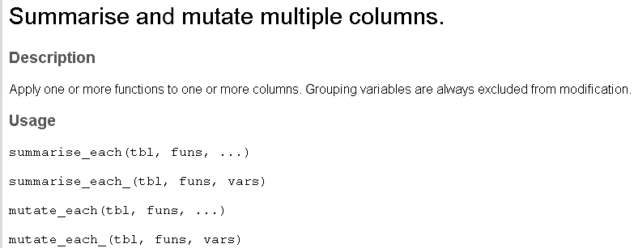

dplyr
summarise_each
> new_titanic %>%
+ group_by(Sex) %>%
+ summarise_each(funs(sum), Freq, portion)

Slide 125
dplyr
Count
Distinct
> titanic %>%
+ select(Sex) %>%
+ summarise_each(funs(n()))
Sex
1 32
> titanic %>%
+ select(Sex) %>%
+ summarise_each(funs(n_distinct(Sex)))
Sex
1 2

Slide 126
dplyr
summarise (sum) + group_by + arrange(order by)
> titanic %>%
+ group_by(Age, Sex) %>%
+ summarise(fs = sum(Freq)) %>%
+ arrange(desc(fs))
Age Sex frequency_sum
1 Child Male 64
2 Child Female 45
3 Adult Male 1667
4 Adult Female 425

Slide 127
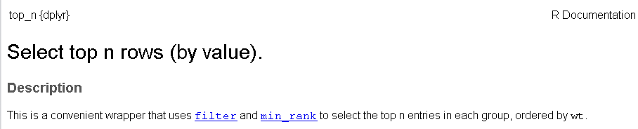
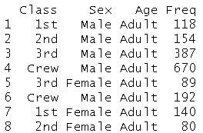
dplyr
top_n
# find top 2 of each class
> titanic %>%
+ group_by(Class) %>%
+ select(Sex,Age,Freq) %>%
+ top_n(2)

Slide 128
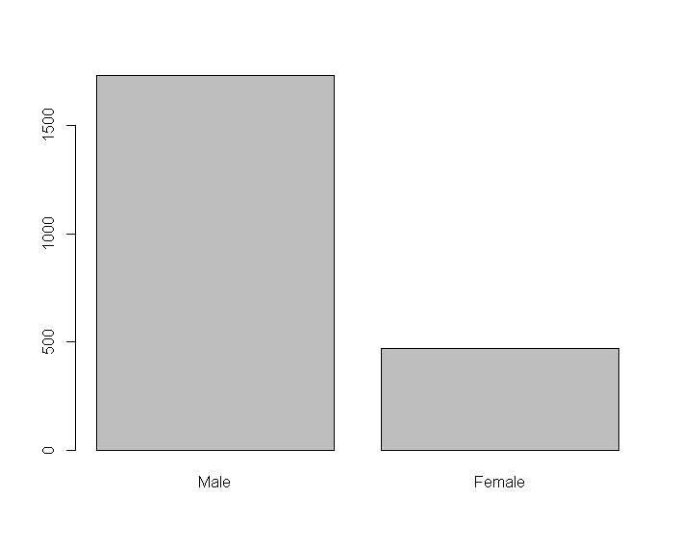
dplyr
plot + dplyr
> data = titanic %>%
+ group_by(Sex) %>%
+ summarise(Sexsum = sum(Freq, na.rm=TRUE))
Sex Sexsum
1 Male 1731
2 Female 470
> barplot(data$Sexsum, names.arg=data$Sex)

Slide 129
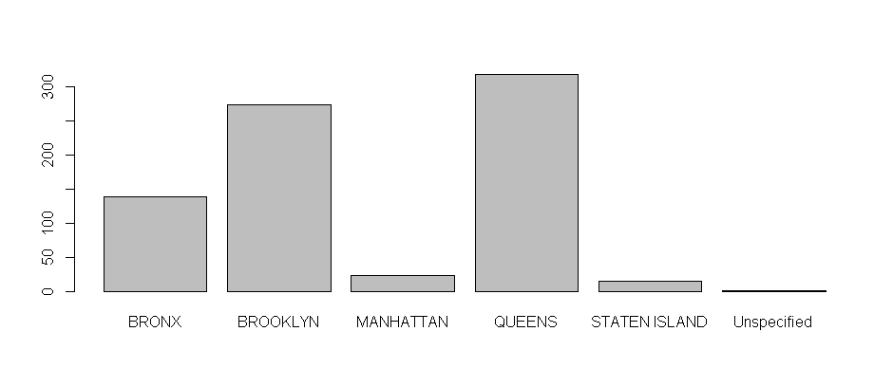
Exercise
Dataset:
311 dataset from NYC
https://data.cityofnewyork.us/Social-Services/311-Service-Requests-from-2010-to-Present/erm2-nwe9
311.csv
How many complaints of each type?
Column Name: Complaint.type
How many complaints about "Blocked Driveway" of each borough?
Column Name: Borough

Slide 130
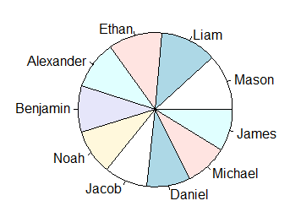
dplyr
Common name in English in 2012
> data = read.csv("name_english.csv",sep=",", header=F)
> colnames(data) = c("sex", "year", "name", "freq")
> top10_female = data %>%
+ filter(year == "2012" & sex == "F") %>%
+ group_by(name) %>%
+ summarise(count = sum(freq)) %>%
+ arrange(desc(count)) %>%
+ head(10)
> top10_male = data %>%
+ filter(year == "2012" & sex == "M") %>%
+ group_by(name) %>% summarise(count = sum(freq)) %>%
+ arrange(desc(count)) %>%
+ head(10)
> pie(top10_male$count, label = top10_male$name)

Slide 131
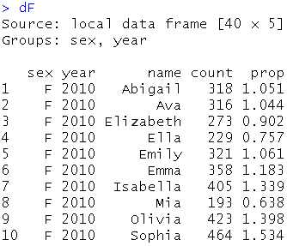
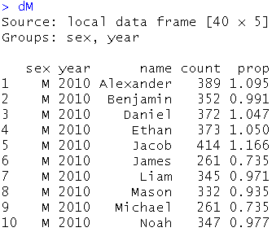
dplyr
Common name in English
> dF = data %>%
> group_by(sex, year, name) %>%
> summarise(count = sum(freq)) %>%
> group_by(sex, year) %>%
> mutate(prop = round(count * 100/sum(count), 3)) %>%
> filter(name %in% top10_female$name)
> dM = data %>%
> group_by(sex, year, name) %>%
> summarise(count = sum(freq)) %>%
> group_by(sex, year) %>%
> mutate(prop = round(count * 100/sum(count), 3)) %>%
> filter(name %in% top10_male$name)
#> install.packages("ggplot2")
> library(ggplot2)
> ggplot(data = dF, aes(x=year, y=count, group=name)) + geom_path(aes(colour=name)) + + geom_point(aes(colour=name))
> ggplot(data = dM, aes(x=year, y=count, group=name)) + geom_path(aes(colour=name)) + + geom_point(aes(colour=name))

Slide 132
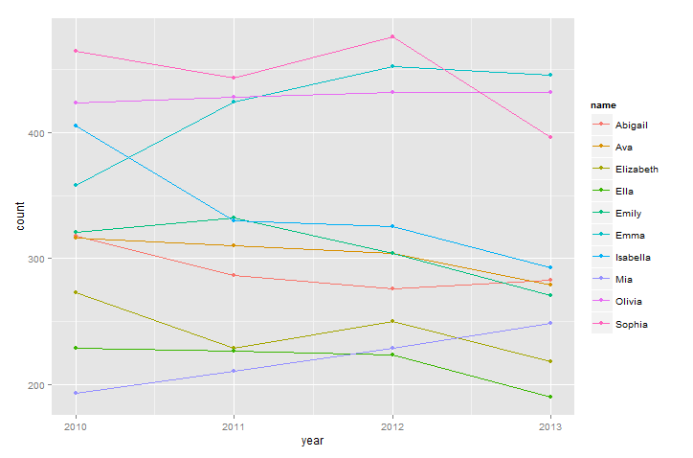
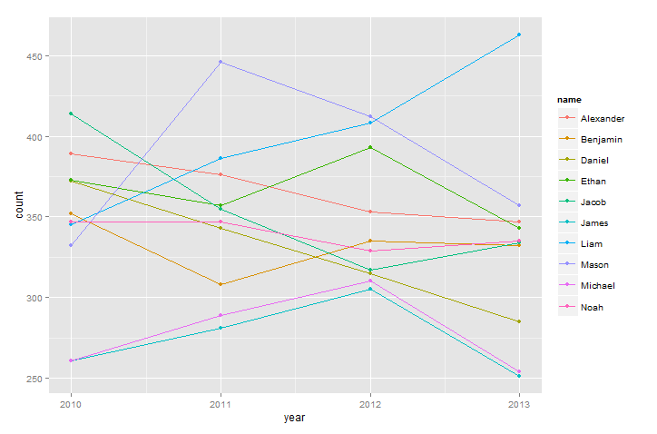
dplyr
Common name in English

Slide 133
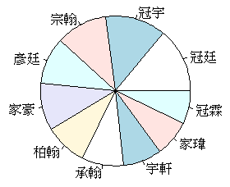
dplyr
菜市場名
> data = read.csv("name_chinese.csv",sep=",", header=F)
> colnames(data) = c("sex", "year", "name", "freq")
> top10_female = data %>%
+ filter(year == "2012" & sex == "F") %>%
+ group_by(name) %>%
+ summarise(count = sum(freq)) %>%
+ arrange(desc(count)) %>%
+ head(10)
> top10_male = data %>%
+ filter(year == "2012" & sex == "M") %>%
+ group_by(name) %>% summarise(count = sum(freq)) %>%
+ arrange(desc(count)) %>%
+ head(10)
> pie(top10_male$count, label = top10_male$name)

Slide 134
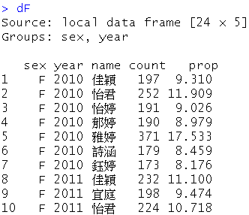
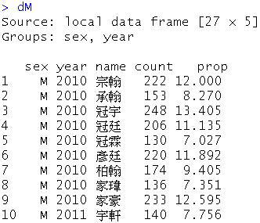
dplyr
菜市場名
> dF = data %>%
> group_by(sex, year, name) %>%
> summarise(count = sum(freq)) %>%
> group_by(sex, year) %>%
> mutate(prop = round(count * 100/sum(count), 3)) %>%
> filter(name %in% top10_female$name)
> dM = data %>%
> group_by(sex, year, name) %>%
> summarise(count = sum(freq)) %>%
> group_by(sex, year) %>%
> mutate(prop = round(count * 100/sum(count), 3)) %>%
> filter(name %in% top10_male$name)
#> install.packages("ggplot2")
> library(ggplot2)
> ggplot(data = dF, aes(x=year, y=count, group=name)) + geom_path(aes(colour=name)) + + geom_point(aes(colour=name))
> ggplot(data = dM, aes(x=year, y=count, group=name)) + geom_path(aes(colour=name)) + + geom_point(aes(colour=name))

Slide 135
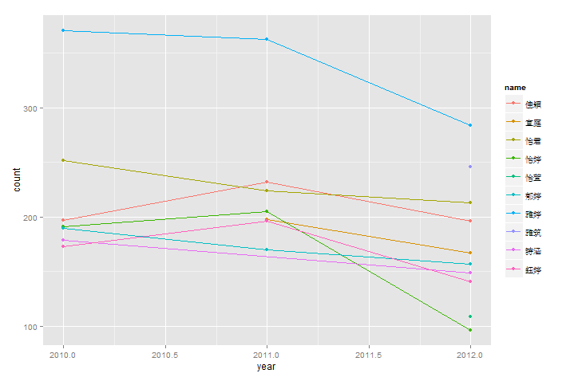
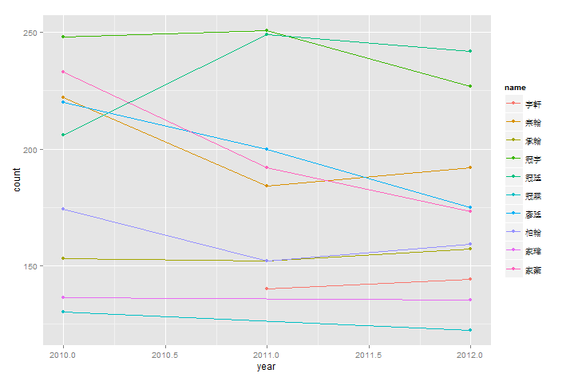
dplyr
菜市場名

Slide 136
R calling C/C++

Slide 137
R calling c
Data type
R storage mode | C type
logical | int *
integer | int *
double | double *
character | char **

Slide 138
R calling c (linux)
System call
test1.c
#include <stdio.h>
void main()
{
printf("Hello World\n");
}
> system ("./test1.out")
Hello World
gcc –o test1.out test1.c

Slide 139
R calling c function (linux)
test2.c
> dyn.load("test2.so")
> result<-.C("A",a="")
> result$a
[1] "Hello World!"
void A(char **a) {
*a = "Hello World!";
}
R CMD SHLIB test2.c #generate test2.so test2.o

Slide 140
R calling c function (linux)
test3.c
#include <string.h>
void count_len(char **str, int *len) {
*len = strlen(*str);
}
R CMD SHLIB test3.c #generate test3.so test3.o
> dyn.load("test3.so")
> result<-.C("count_len",str="Hello" ,len=as.integer(0))
> result$len
[1] 5
> result<-.C("count_len",str="World!!" ,len=as.integer(0))
> result$len
[1] 7
> result<-.C("count_len",str="World!!" )
> result$len
NULL

Slide 141
R calling c function (linux)
> dyn.load("test3.so")
> test<-function(s){
+ result<-.C("count_len",str=s ,len=as.integer(0))
+ return (result$len)
+ }
> test("Hello")
[1] 5
> test("World!!")
[1] 7

Slide 142
R calling Python / Perl (linux)
System call
hello.py
> system ("./hello.pl")
Hello World!!
> system ("./hello.py")
Hello World!!
#!/usr/bin/python
print("Hello World!!")
hello.pl
#!/usr/bin/perl -w
print "Hello World!!\n";
chmod +x hello.py
chmod +x hello.pl

Slide 143
Calling R
C/C++
Rcpp
Java
Rcaller
Perl
Python
rpy2
open R,"|/usr/bin/R --vanilla --slave";
print R <<EOF
R CODE
EOF

Slide 144
Q & A

